Slide 1
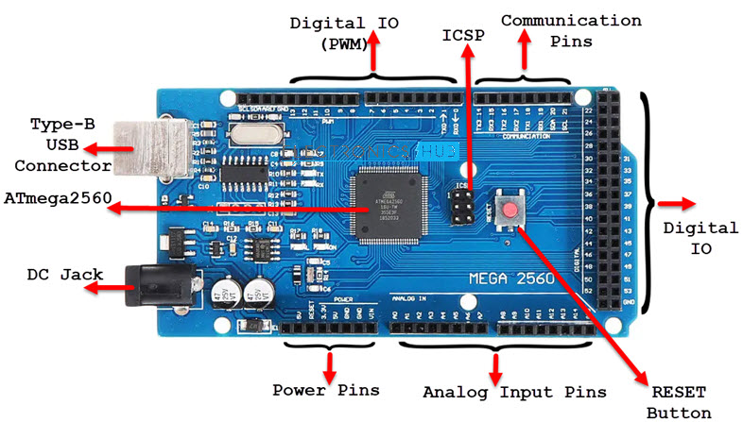
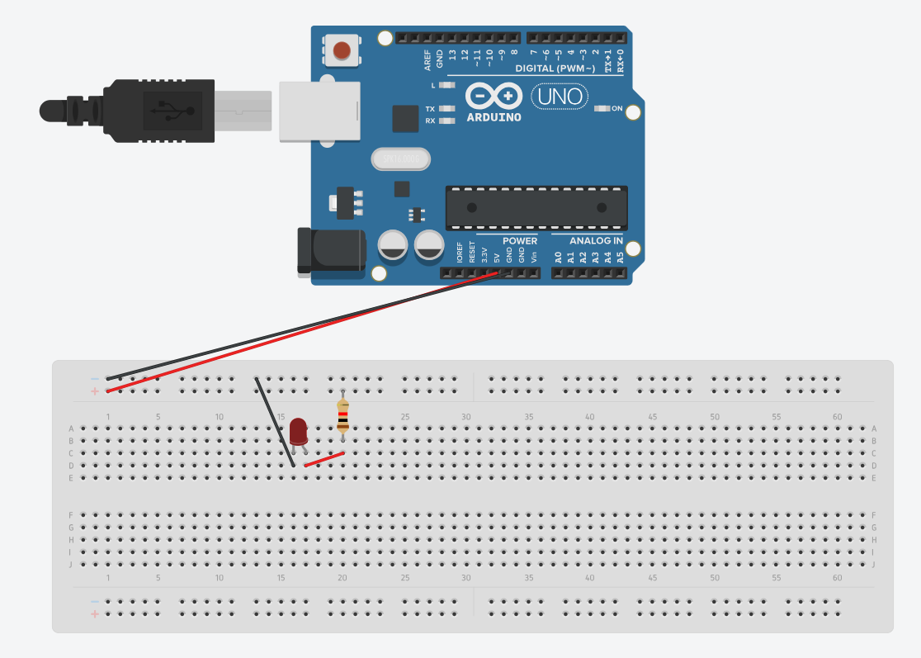
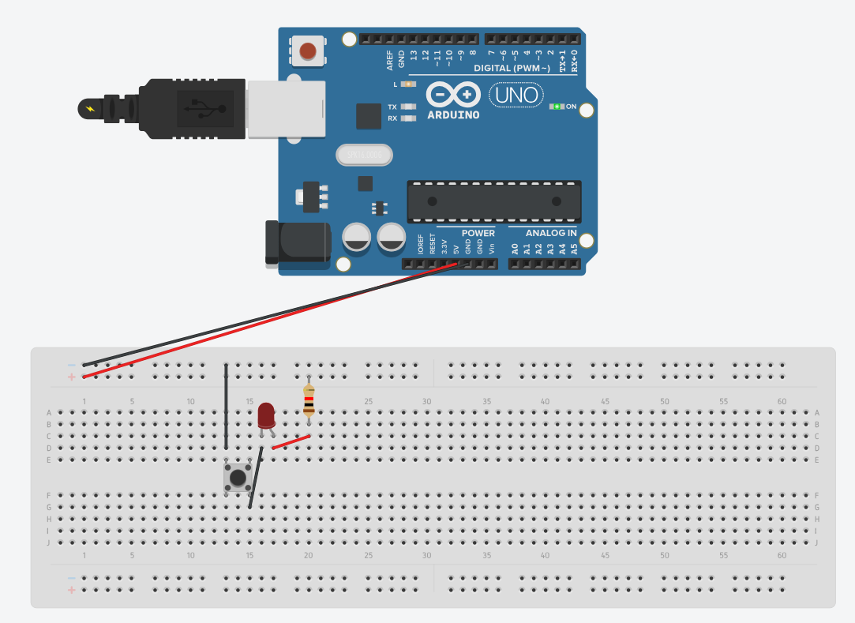
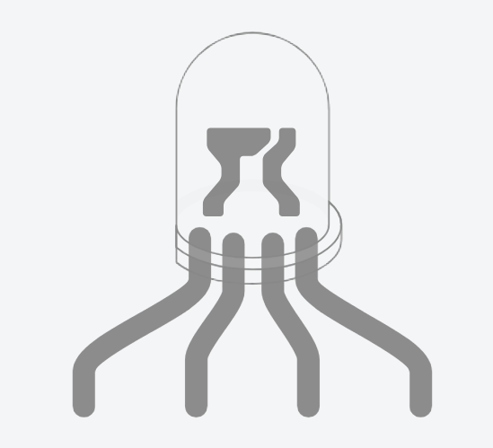
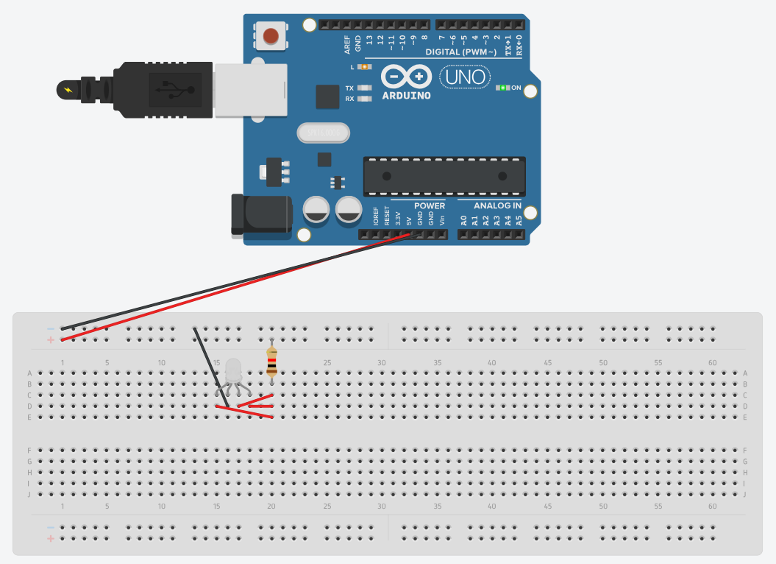
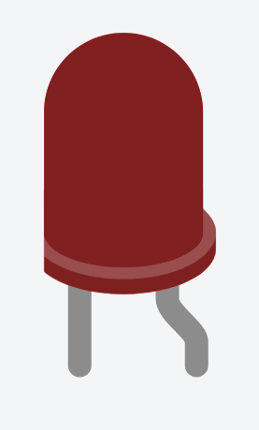
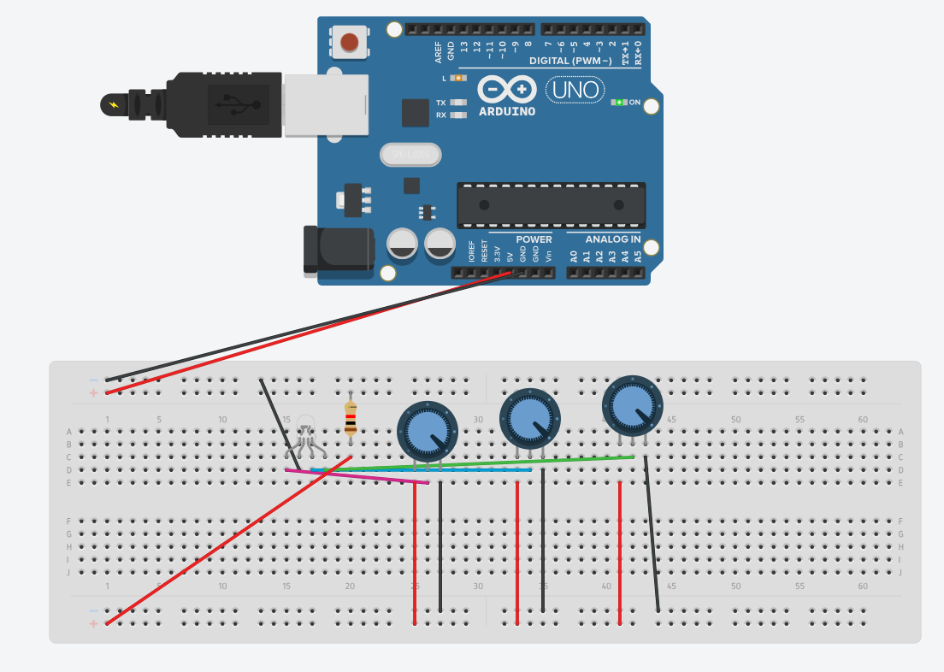
HARDWARE RECAP
Component Insertion:
To use a breadboard, insert the leads of electronic components like resistors, LEDs, and ICs into the appropriate holes. Ensure the leads make contact with the metal strips underneath.
Power Rails:
Rows of interconnected holes along the sides known are as power rails. Connect power (usually 5V or 3.3V) and ground wires to these rails to provide power to your circuit.
LED
Button +LED
PWR (+)
GND (-)
Extra help:
Connect 2 jumper wires from:
5V (5V of power on your arduino → +/red line on breadboard
GND (ground on your arduino) → -/blue line on breadboard
RGB
RP + RGB
RED
GREEN
BLUE
GND (-) PWR (+)
GND

Slide 2
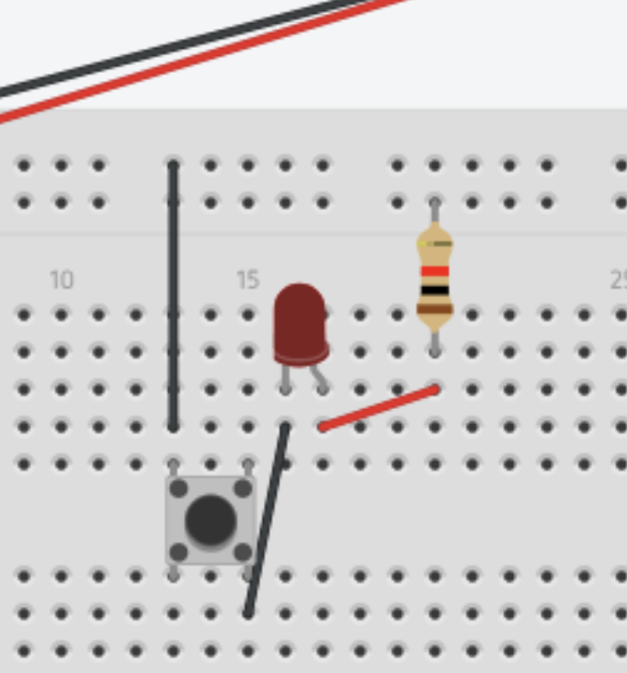
RESISTORS:
You must use resistors when connecting LEDs and other components to a circuit, otherwise the components will break.
For 5V connections, use a 100 ohm resistor between the PWR pin LED and the wire connection.

Slide 3
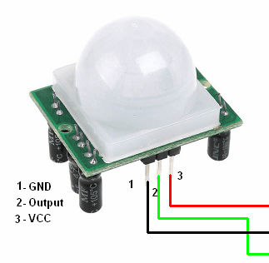
Light/Motion Sensors:
Motion sensors can change the output voltage as well.
VCC is the same as PWR (+)

Slide 4
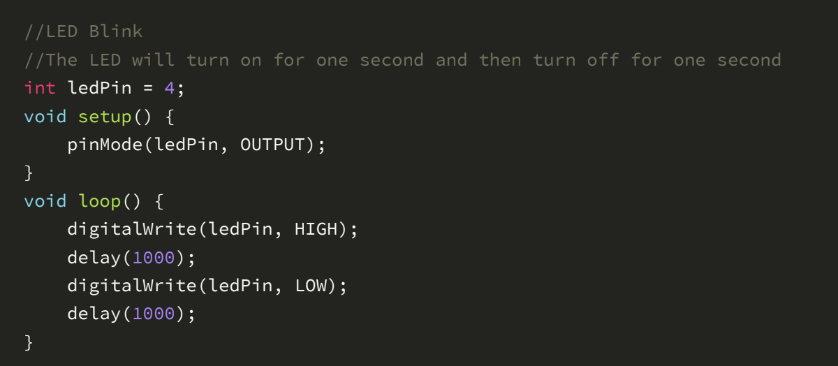
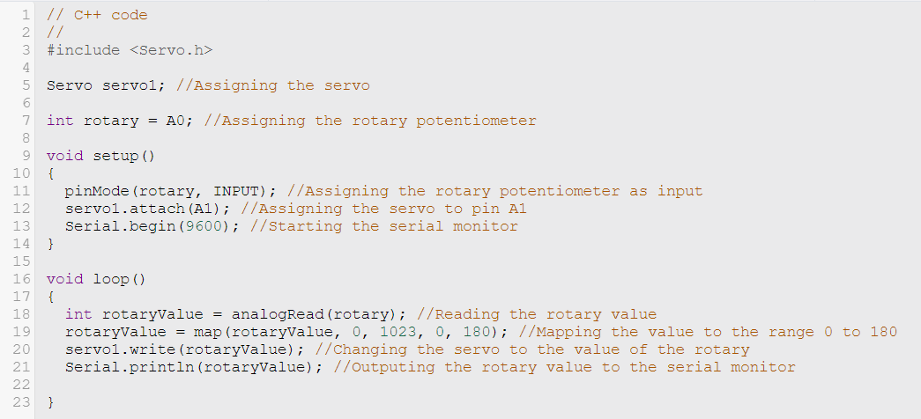
CODING RECAP
// - to create a comment that won’t affect the code
int variable - stores integer numbers as a variable eg 123
void setup () - a function that runs the setup and defines input and output inside it
void loop() - a function that runs continuously in a loop
pinMode(pin , INPUT / OUTPUT) - defines what is connected to that number pin as a input or output
digitalWrite(pin, data) - writes the data/value to the pin eg, HIGH power to pin 4, so LED turns on.
delay(time in ms) - delays the code by a set time in milliseconds
Remember to use ; after a function.
LED BLINK
Rotary Potentiometer + Servo Motor

Slide 5
PASSWORDS:
Your Account Password will be the same as your Username:
Account number (Single digit) Account number(double digit)
Try: Try:
Media01 Media11
Media01 media11
Media1
media1

Slide 6
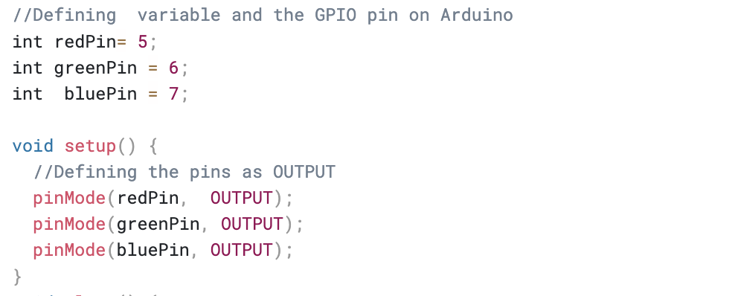
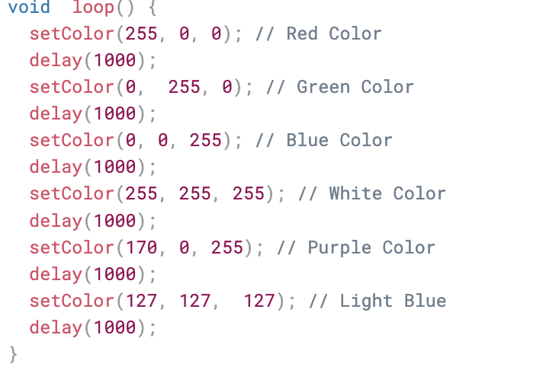
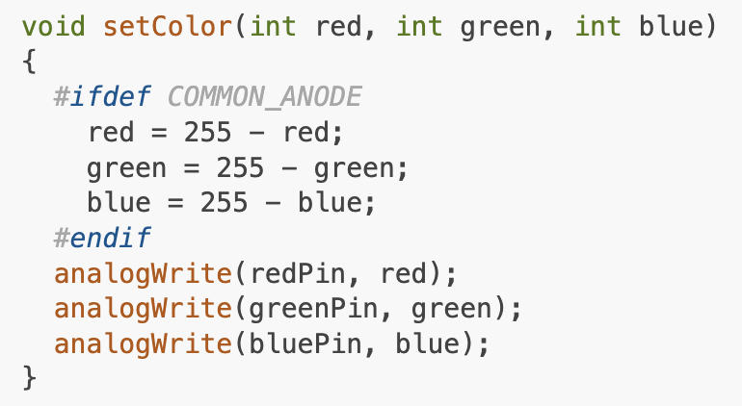
Term 1&2 2024/5
Today: Begin by making a blinking RGB LED Circuit with different colours:

